Slide 1
Analysing scraped customer review data to uncover findings for British Airways
Niloofar Moosavi

Slide 2
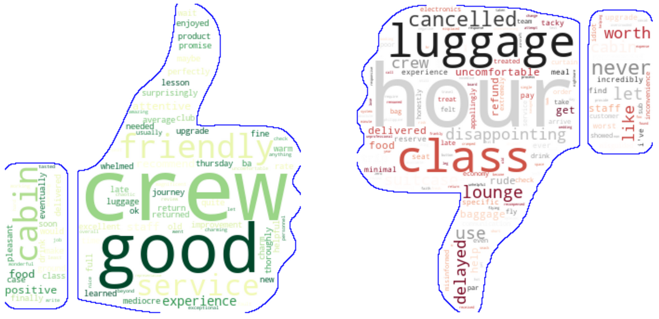
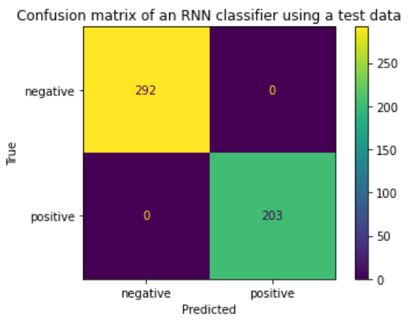
Reviews’ header analysis
100% sentiment prediction accuracy using reviews
More positive feedbacks on crew and service
More negative feedbacks on luggage, lounge, cancelled and delayed flights

